Slide 1
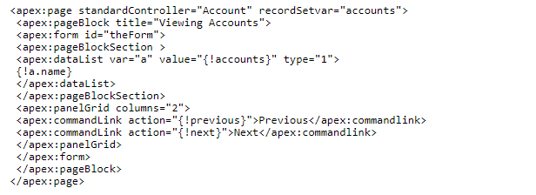
How can we implement pagination in Visualforce?
To control the number of records displayed on each page, we use pagination. By default, a list controller returns 20 records on the page.
To customize it, we can use a controller extension to set the pageSize. Take a look at the sample code below:-

